Slide 1
English Writing II
S01E01 Course introduction
ZHU Ye 朱晔

Slide 2





Preparation

Slide 3
Starting with big questions …
What – Topics of writing
Why – Purpose of writing
How – Linguistic, rhetorical & writing techniques

Slide 4
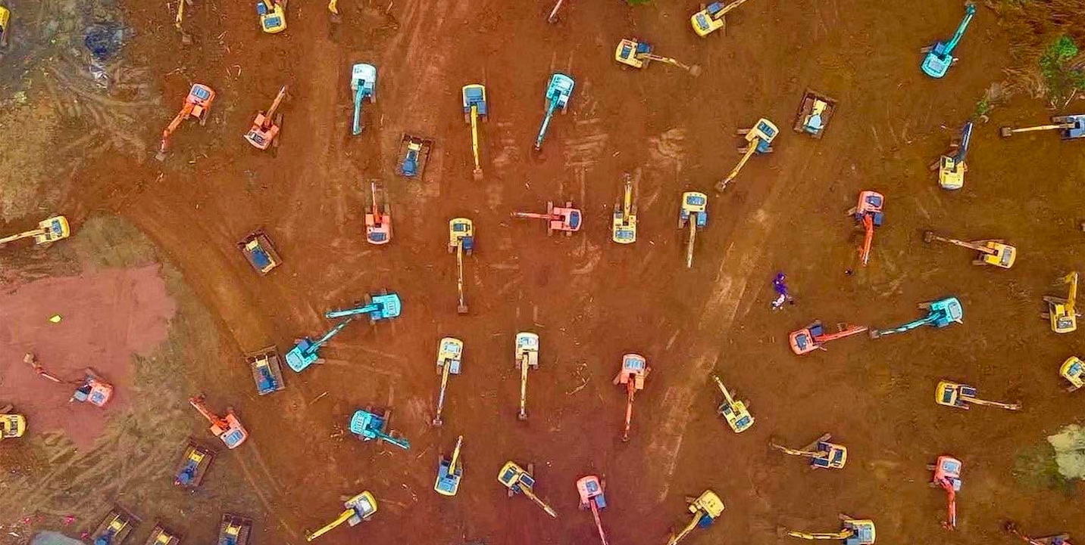
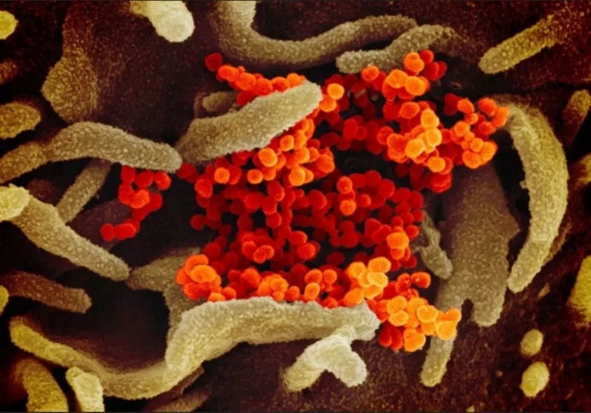
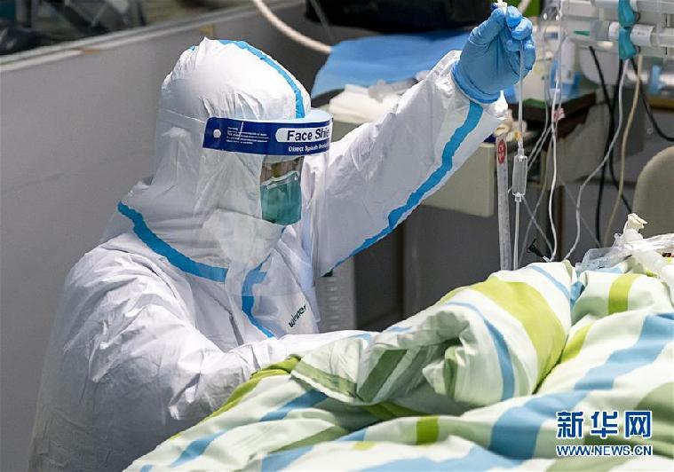
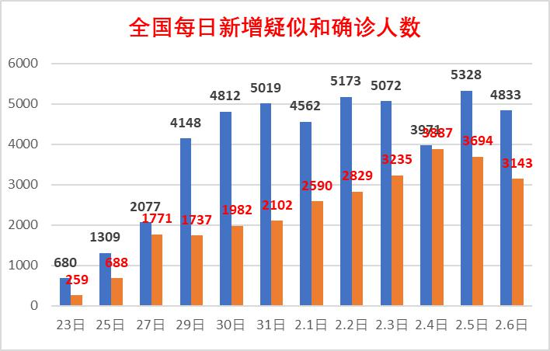
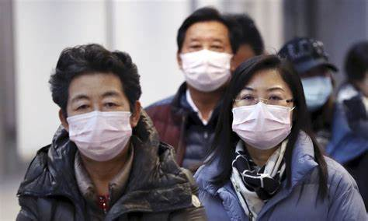
Topic: Life in the time of “Corona”

Slide 5



Fictions

Slide 6
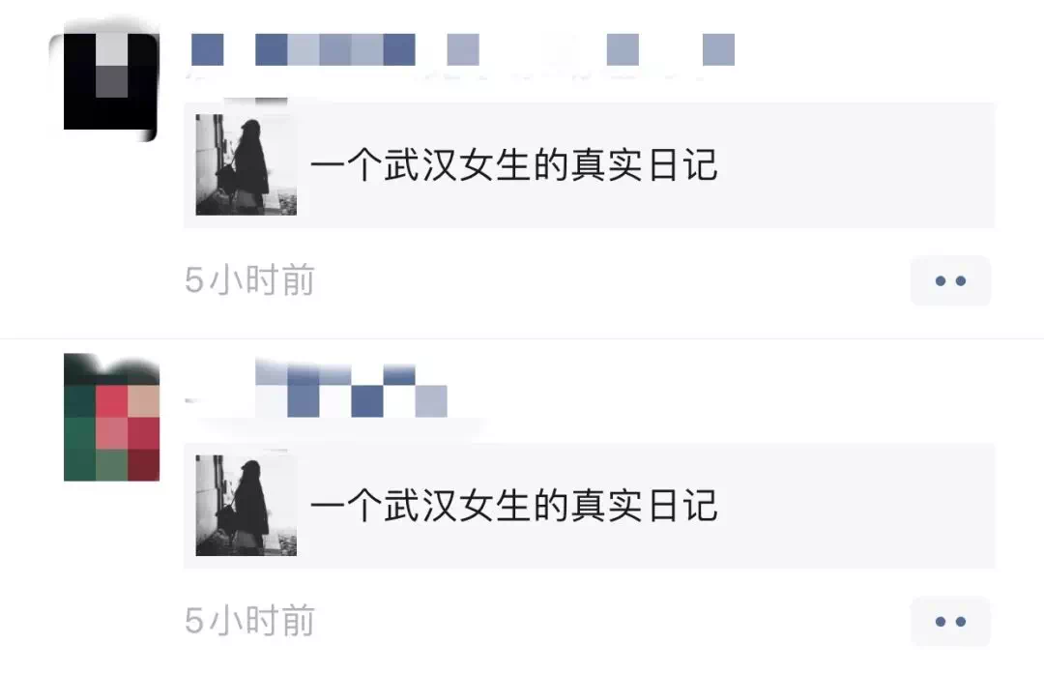
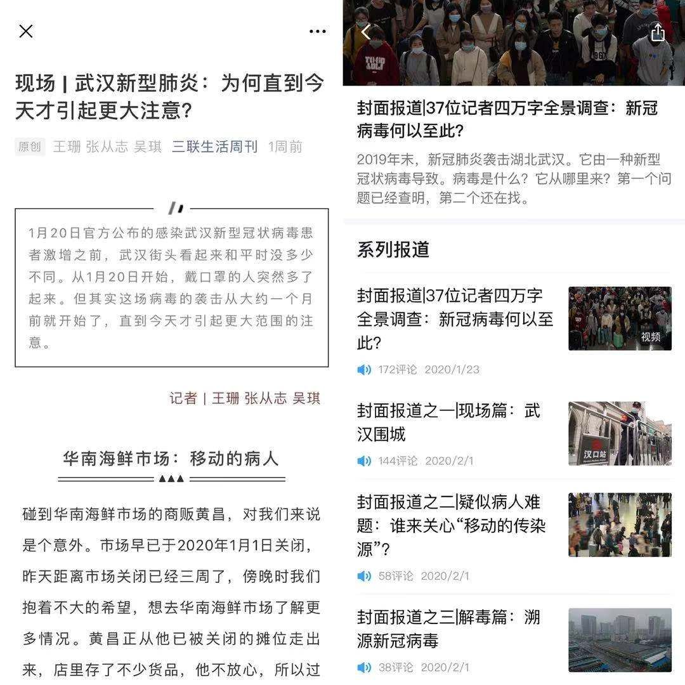
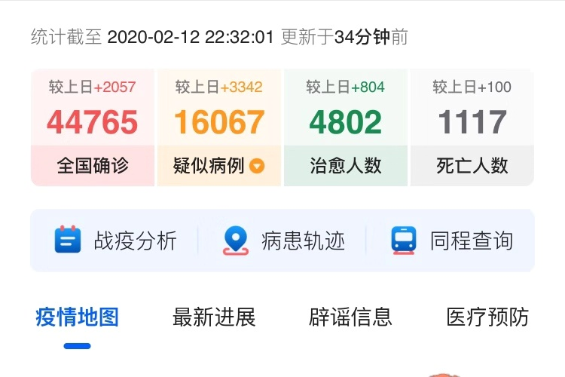
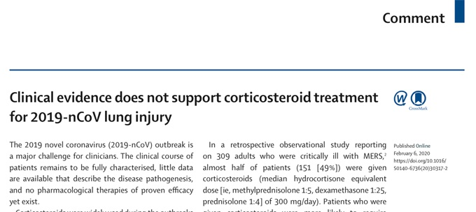
Non-fictions

Slide 7
Purposes of writing
→ informative and expository
→ expressive and imaginative
→ persuasive and argumentative

Slide 8
Good writing
An genuine PURPOSE: to explain, describe, argue etc.
A specific AUDIENCE: someone who cares
Sufficient DETAILS: first-hand experiences, careful observations, reliable sources, facts and data
A clear STRUCTURE: to channel the facts and feelings in a logical organization

Slide 9
Goals for the course
Informed nonfiction writing – reading for writing
Narrative, descriptive and argumentative
Details, ideas and facts
Argument and evidence

Slide 10




Reference books

Slide 11

Course evaluation
Course participation – 10%
In-class writing (notebook) – 20%
Assignments – 20%*2 = 40% (800-1000 words)
Final paper – 30% (1200-1500 words)

Slide 12
Lesson plan (Week 1-6) – Reading
Nature’s Bioterrorist and Stopping A Global Killer
1. Reading for general understanding
2. Selective reading of some sections/ paragraphs
3. Close-up reading of writing skills and expressions

Slide 13
Lesson plan (Week 1-6) – Writing
Vocabulary and ideas preparation
In-class writing tasks (200-300 words)
Assignment (800-1000 words) due in Week 6

Slide 14
General requirements
Read and analyze the materials beforehand
Make good use of your notebook/ writing pad
Immediate submission after class (course.zju.edu.cn)
Q&A on DingTalk

Slide 15
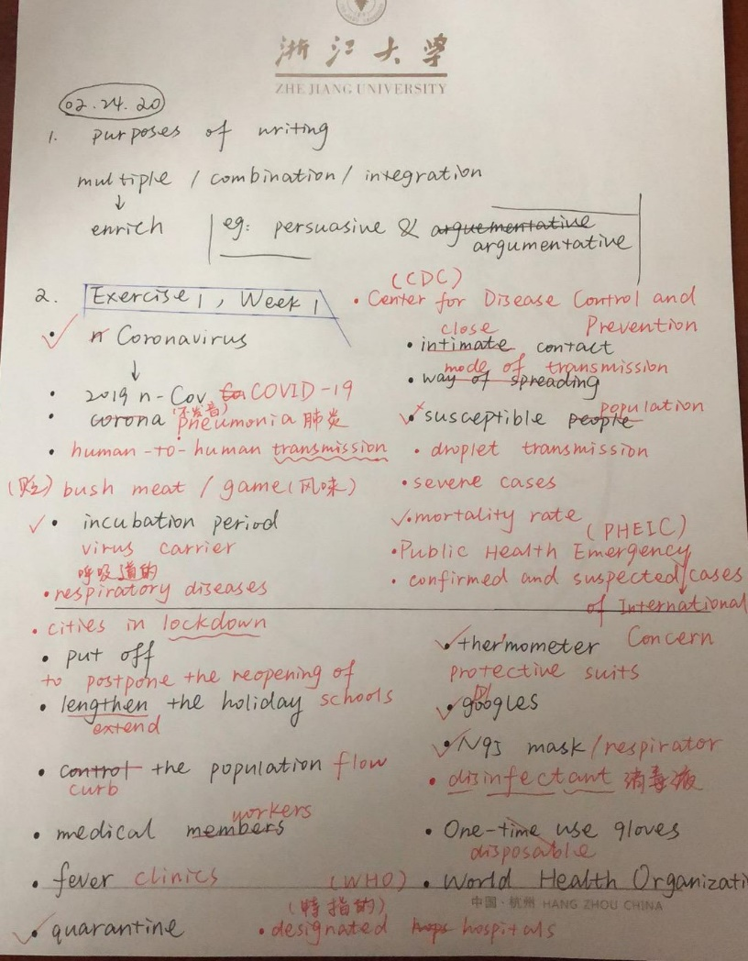
Note-taking & in-class writing

Slide 16
In-class writing 101: Vocabulary
冠状病毒
新冠肺炎
肺炎
呼吸道疾病
人传人
潜伏期
病毒携带者
飞沫传播
密切接触
传播方式
易感人群
确诊病例/疑似病例
重症病例
致死率
野味
国际关注的突发公共卫生事件

Slide 17
In-class writing 101: Vocabulary
封城
延迟开学
延长假期
控制人口流动
医疗人员
发热门诊
定点医院
隔离
体温计
防护服
护目镜
N95口罩
消毒液
一次性手套
世卫组织
疾控中心

Slide 18
Vocabulary
冠状病毒 coronavirus
新冠肺炎 COVID-19
肺炎 pneumonia
呼吸道疾病 respiratory diseases
人传人 human-to-human transmission
潜伏期 incubation period
病毒携带者 virus carrier
飞沫传播 droplet transmission

Slide 19
Vocabulary
密切接触 close contact
传播方式 mode of transmission
易感人群 susceptible/vulnerable population
确诊病例\疑似病例 confirmed and suspected cases
重症病例 severe cases
致死率 mortality/fatality rate
国际关注的突发公共卫生事件
Public Health Emergency of International Concern (PHEIC)

Slide 20
Vocabulary
封城 cities in lockdown
延迟开学 to postpone the reopening of schools
延长假期 to extend the holiday
控制人口流动 to curb population flow
医疗人员 medical workers
医疗物资紧缺 shortage of medical supplies
发热门诊 fever clinics
定点医院 designated hospitals
隔离 quarantine

Slide 21
Vocabulary
体温计 thermometer
防护服 protective suits
护目镜 goggles
N95口罩 N95 masks/respirators
消毒液 disinfectant
一次性手套 disposable gloves
世卫组织 World Health Organization (WHO)
疾控中心 Center for Disease Control and Prevention (CDC)
野味 bush meat/ game

Slide 22
In-class writing (30 minutes)
TOPIC: A Typical Day in the Time of “Corona”
PURPOSE: to describe, to narrate and to explain
Word count: 300-400 words
Detail, Perspective, Focus

Slide 23
Homework
Submit the writing (by midnight @course.zju.edu.cn)
Review the wordlist
Disambiguation: epidemic, pandemic, endemic
First reading: Nature’s Bioterrorist
→ Identify the major events reported in the article
→ Readings about Pandemics\Nature's bioterrorist（2005）.pdf

Slide 24

For further questions …
DingTalk
Stay tuned for Episode 2 next week…

